Slide 1

Artificial Intelligence for Business Decisions and Transformation
CSCN8030 - Spring 2024 - Section 2
Sprint 6 - Design
July 29, 2024
Group 4 - Members:
Krishna Kumar, Hemasree
Shijin, Jency
Fernandez, Arcadio
Professor:
Glaucia Melo dos Santos, PhD

Slide 2
Agenda
1. Group members role
2. Problem Statement
3. Dataset
4. Project Pitch
5. Sprint Planning

Slide 3


1. Group members role
Product owner
Developers
Jency
Arcadio
Hema
Connects with the customer
Contributes to the vision and roadmap
Manages and prioritizes the team backlog
Supports the team in delivering value
Continuously evolves product design
Implements the vision and roadmap
Works on the team backlog
Builds, tests, and delivers increments of value

Slide 4
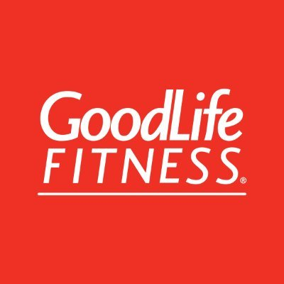
2. Problem Statements
1. Optimizing Group Fitness Class Utilization
Objective: Increase the number of available spaces for fitness classes by predicting member attendance and reallocating spaces from predicted absences.
Techniques: Predictive modeling, Logistic regression, Decision trees, Random Forest
Outcome: Higher utilization rate of fitness class spaces, reduced class wait times, and improved member satisfaction due to better space management
2. Optimizing Gym Equipment Utilization
Objective: Estimate the number of people using the gym at different times of day to maximize equipment availability and promote use.
Techniques: Feature selection techniques, Feature engineering, predictive analytics, Regression techniques
Outcome: Accurate predictions of gym crowd levels, which allows for better scheduling and improved equipment availability during peak times.

Slide 5
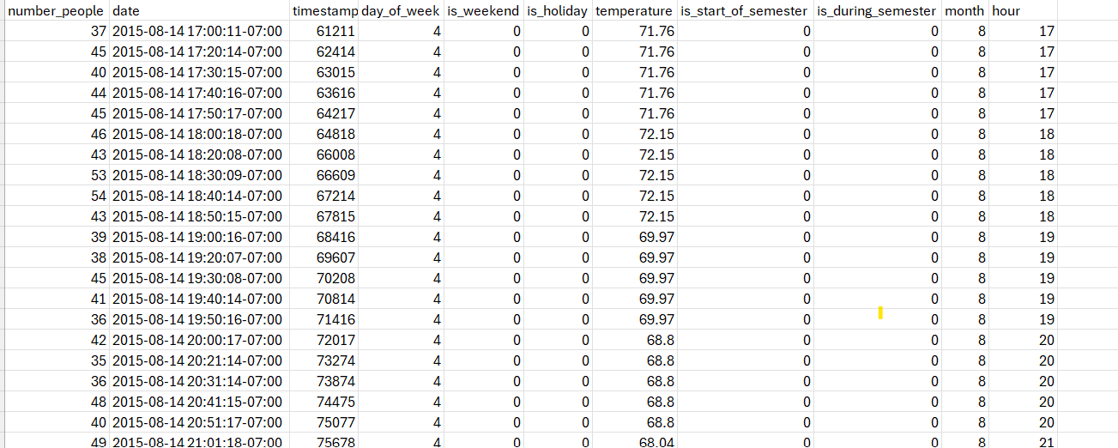
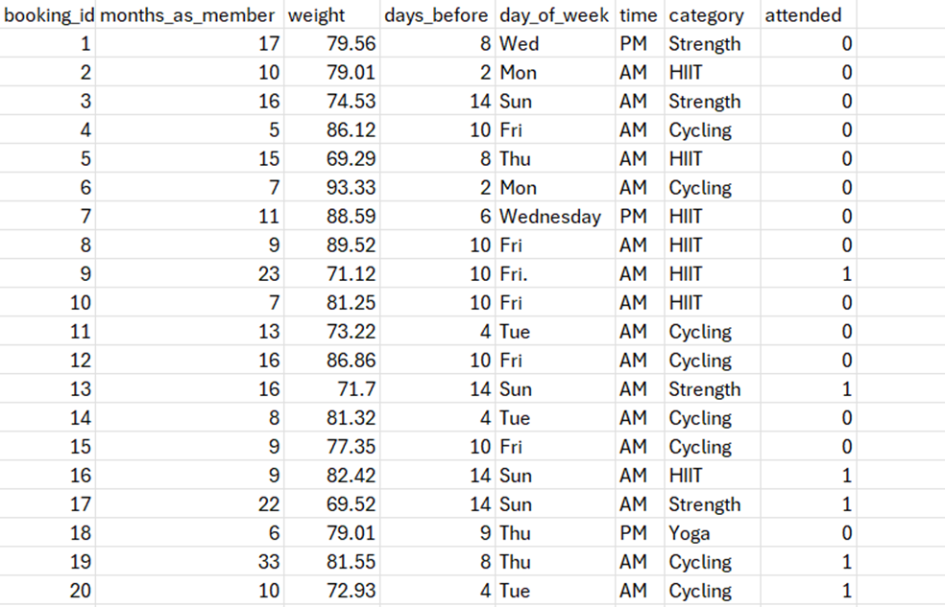
3. Analyzing the Dataset
Gym Crowd Level data
Member Class Booking data
1500 records about members attending different classes
26,000 people counts (about every 10 minutes) over the last year. Total rows - 62184

Slide 6

5. Project Pitch
Enhancing Utilization of Fitness Classes and Gym Equipment
Project Pitch | BUSINESS
Organization or Category | Fitness Club Chain (GoodLife)
Description of Organization | GoodLife Fitness is one of Canada's largest fitness chains, boasting over 450 locations nationwide. It offers a diverse range of services including group fitness classes, personal training, and state-of-the-art gym equipment. Known for its inclusive and supportive environment, GoodLife Fitness emphasizes accessibility and community engagement, leveraging technology like a mobile app and virtual classes to enhance the member experience.
Two Specific Ethical Considerations in AI Adoption | 1. Data Privacy: Collecting and using member data for predictive analytics raises concerns about data privacy and security. Ensuring transparency and obtaining informed consent from members is crucial. 2. Bias and Fairness: AI models may inadvertently perpetuate biases if trained on imbalanced data, potentially leading to unfair outcomes (e.g., certain groups being less likely to secure spots in popular classes).

Slide 7
5. Project Pitch
Enhancing Utilization of Fitness Classes and Gym Equipment
Three Examples of Operational Decisions | Class scheduling: AI-driven predictions can inform optimal scheduling of fitness classes to minimize conflicts and maximize attendance. Staff allocation: Assist more effectively allocate resources and staff based on projected gym and class attendance. Equipment maintenance: Identify patterns in equipment usage to optimize maintenance schedules and minimize downtime. .
Three Examples of Tactical Decisions | Marketing campaigns: AI-driven insights can inform targeted marketing campaigns to promote underutilized classes or gym equipment. Dynamic pricing: Helps in implementing dynamic pricing strategies to optimize revenue based on predicted demand for classes and gym usage. Capacity planning: Capacity expansion and contraction decisions can be made using predictive analytics to forecast changes in membership and consumption.

Slide 8
5. Project Pitch
Enhancing Utilization of Fitness Classes and Gym Equipment
Three Examples of Strategic Decisions | Investment in new technologies: Strategic decisions can be taken on the acquisition of new technology to improve member experience and maintain competitiveness. Expansion or contraction: Informed decisions on expanding or contracting GoodLife's footprint can be taken based on anticipated market demand. Partnerships and collaborations: Helps in identifying opportunities for strategic partnerships or collaborations to enhance GoodLife's offerings and reach.

Slide 9
5. Project Pitch
Enhancing Utilization of Fitness Classes and Gym Equipment
Why this is topic important? | Optimizing gym utilization and predicting member behavior can significantly enhance member satisfaction, increase revenue, and inform data-driven decisions to stay competitive in the fitness industry.
How could this project make an impact outside of class? | This plan can improve the entire member experience and serve as a model for other fitness clubs by helping to build AI-driven solutions for the fitness sector.
Why should class choose this topic? | This project offers a unique opportunity to apply AI and machine learning techniques to a real-world problem, providing a rich dataset for analysis and the potential to drive significant impact in the fitness industry.

Slide 10
6. Sprint Planning
Tasks | Owner | Priority | Sprint | Story Points | Estimated Effort in Hours
Perform Data cleaning by handling missing values, correcting data types, and ensuring data consistency. | Arcadio | med | 6 | 3 | 1
Explore the two datasets to understand its structure, features, and distributions to gain key insights into class attendance and gym equipment utilization | Arcadio | med | 6 | 3 | 1
Identify relevant features such as Member engagement and class popularity for Group Fitness Class Utilization. Time, weather, holiday, and semester effects for Gym Equipment Utilization | Hema | High | 6 | 5 | 1
Encode categorical variables into numerical format using techniques like one-hot encoding or label encoding. | Hema | High | 6 | 5 | 2
Scale numerical features to ensure they have similar ranges, which can improve the performance of ML algorithm. | Hema | Med | 6 | 3 | 1
Choose appropriate prediction algorithms based on business objectives for each problem. | Jency | Med | 6 | 3 | 1
Implement chosen prediction algorithms on the preprocessed dataset. | Jency | Med | 6 | 3 | 1
Evaluate the model performance using metrics like such RMSE. Tune hyperparameters and optimize models. Validate models using cross-validation techniques. | Jency | High | 6 | 5 | 2
Interpret the results to optimize Group Fitness Class and Gym Equipment Utilization | Arcadio | High | 6 | 5 | 2

Slide 11
Thank you
Any Questions

